Slide 1
BASKIN ENGINEERING · UC SANTA CRUZ · APPLIED MATHS
An Interior Step-Size Error Minimum for
Neural Emulators of Dynamical Systems
Fixed-compute tradeoffs among time step, network capacity, and unrolled training
C. Ainslie · August 2026 · working draft

Slide 2
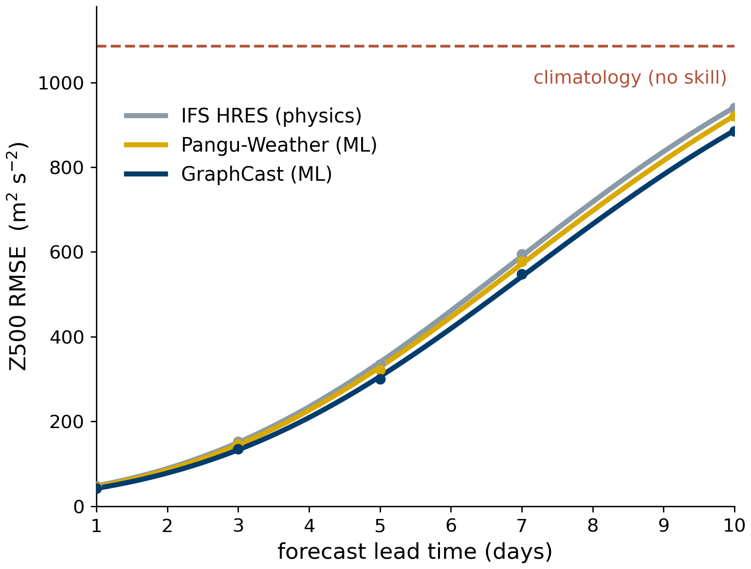
MOTIVATION
Neural emulators in climate modeling
1
Numerical climate models are compute-limited
Integrating the governing equations at fine resolution requires months of supercomputer time; the step size is fixed by numerical stability, not by choice.
2
Neural emulators replace the numerical solver
An autoregressive network advances the state directly; its one-step errors, however, accumulate over the rollout, as observed in current weather emulators.
3
The step size becomes a free design parameter
Absent stability constraints, the emulator may step minutes or days at a time; each Δt alters the target, the architecture, and the training procedure.
4
Current practice selects Δt by convention
Step sizes are typically inherited from the resolution of the training data. This work characterizes the resulting error tradeoff under fixed compute.
Forecast error grows with lead time for physical and learned models alike. Redrawn (approximate) from WeatherBench 2 headline scores (Rasp et al., JAMES 2024; CC BY 4.0).
2

Slide 3
THE QUESTION
At a fixed compute budget, which step size?
Fixing the total FLOP budget renders Δt a well-posed tradeoff: each step size corresponds to a distinct network capacity and training configuration at identical cost.
Fine steps (small Δt)
Coarse steps (large Δt)
Simpler regression target at each step
Many network evaluations per unit time
Correspondingly reduced network capacity
Training unrolls over many autoregressive steps
Few network evaluations per unit time
Correspondingly increased network capacity
More difficult long-step regression target
Training unrolls over few autoregressive steps
Neither limit is a priori preferable; a theory is required that separates the arithmetic role of Δt from its effect on the trained network.
3

Slide 4
SETUP
Integration-constrained emulators
The network predicts a tendency, which a numerical integrator ℋ advances in time; the update therefore carries an explicit factor of Δt by construction.
learned update (Eq. 1)
The one-step generalization error, evaluated along the true trajectory:
one-step error (Eq. 2)
Structural consequence: the state increment is proportional to Δt, and the one-step error ε inherits the same factor.
4

Slide 5
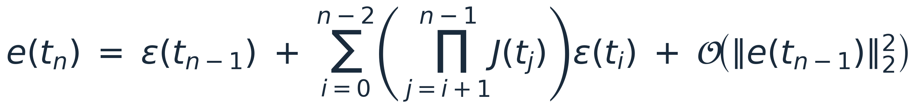
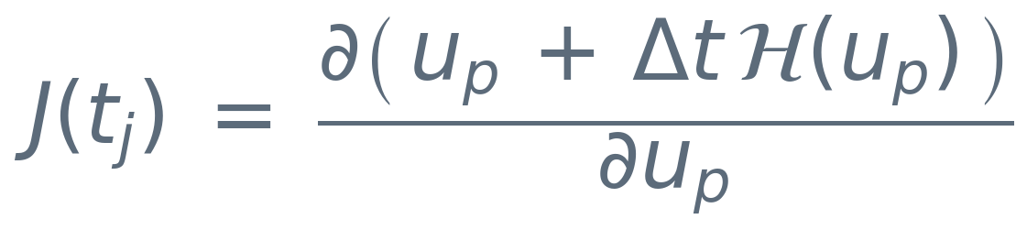
THEORY — STEP 1
From one-step error to rollout error
Unrolling the linearized one-step recursion over n steps decomposes the error into two mechanisms, with J(tⱼ) the full step Jacobian:
unrolled rollout error (Eq. 3)
Injection
Retention
Each step deposits a fresh one-step error ε(tᵢ) into the state; the most recent term enters untouched.
Each earlier error reaches time tₙ through a product of step Jacobians J(tⱼ), which may amplify or attenuate it — the portion retained in the rollout.
To leading order, the rollout error dynamics reduce to these two channels.
5

Slide 6

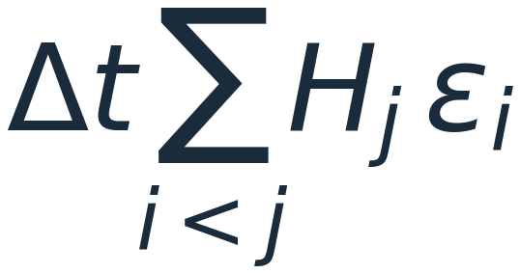
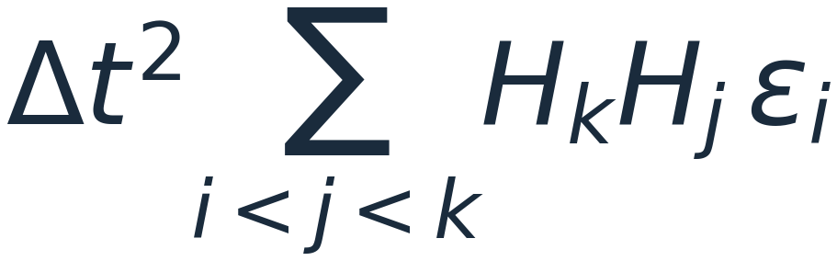
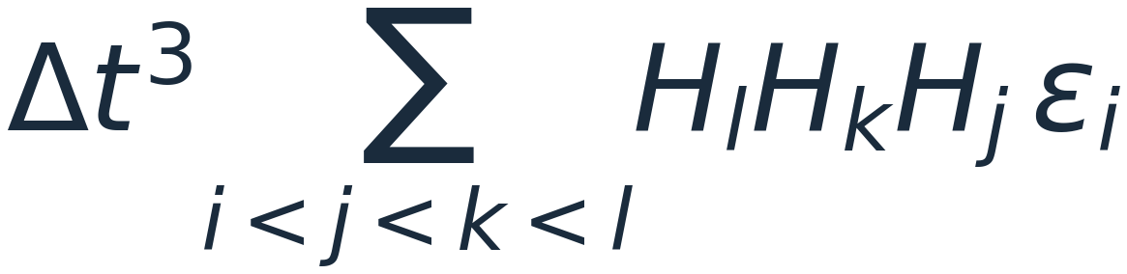
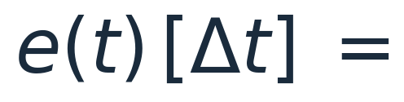
THEORY — THE KEY STEP
How the series reorganizes with Δt
Expanding each Jacobian in Eq. (3) as J = I + Δt∇ℋ and grouping by powers of Δt exposes how the step size weights each order (Hᵢ ≡ ∇ℋ at step i; ordered indices i < j < k < l run over the p = T/Δt steps):
+
+
+
injection — p terms
one Jacobian — O(Δt)
two Jacobians — O(Δt²)
three Jacobians — O(Δt³)
Injection term (k = 0)
Retained terms (k ≥ 1)
One-step errors deposited directly into the state, with no Jacobian applied — the accumulated sum measured next as the injection channel I.
Injected errors carried through k later-step Jacobian factors, each weighted by Δtᵏ — their net contribution measured next as the retained error R.
Per-term weights and term counts pull in opposite directions; the powers of Δt alone do not determine which channel dominates.
6

Slide 7

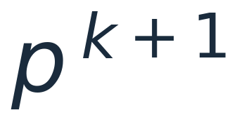

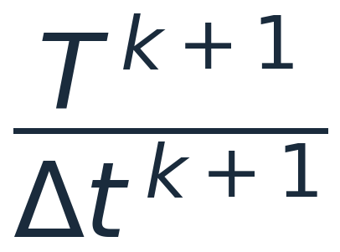
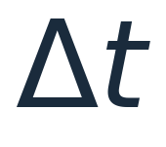
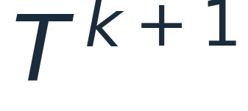
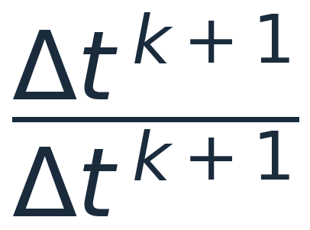
THEORY — RESOLUTION
Expectations reduce the sums to term counts
Taking the expectation along the trajectory replaces each summand by its expected value; an ordered sum over k+1 indices then contributes C(p, k+1) ≈ pᵏ⁺¹/(k+1)! equal terms:
The k-th order term:
·
·
per-term weight
term count
injected error
=
·
·
substituting p = T/Δt and ‖ε‖ ∝ Δt (Eq. 2)
= 1
=
·
→ only Tᵏ⁺¹ survives: no Δt remains.
7

Slide 8
THEORY — RESOLUTION
At fixed physical time, Δt cancels order by order
Substituting p = T/Δt and ε = Δt·ε̄ (Eq. 2; ε̄ is the per-unit-time one-step error, finite as Δt → 0) eliminates Δt at every order:
expected rollout error at fixed T = pΔt
no p and no Δt remain — only the physical horizon T
Halving Δt shrinks the Δt² weight fourfold but quadruples the number of H·ε terms; changing Δt alone shifts nothing between the channels — the Δt-dependence of I and R comes entirely from training and architecture.
8

Slide 9
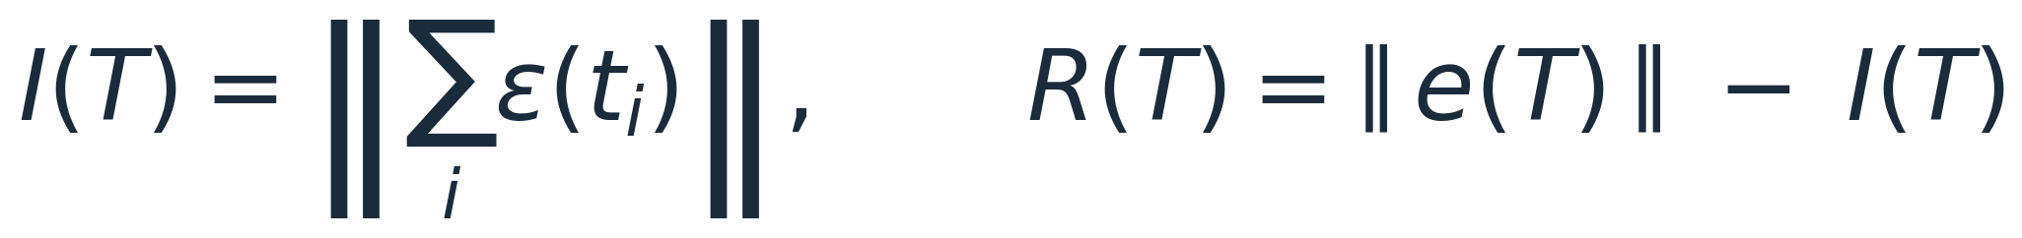
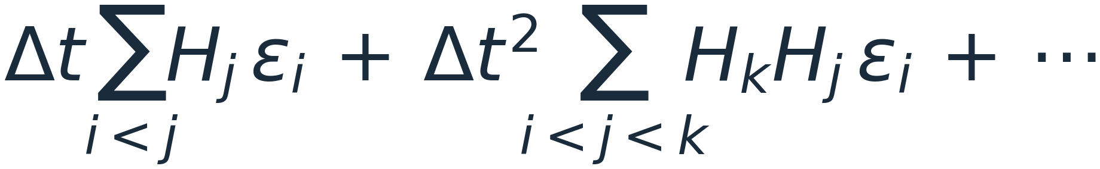
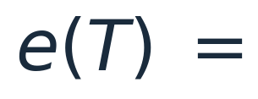
MECHANISM
Decomposing the rollout error into two channels
channel decomposition
Injection I: the accumulated one-step error before any Jacobian is applied — the magnitude of the raw error deposited along the rollout.
Retained error R: the difference ‖e‖ − I between the realized error and the raw injection; negative values indicate net damping of the injected error.
A priori, the two channels are independent and carry no intrinsic Δt-dependence; their behavior under the fixed-compute constraints is established below.
+
injection channel
I(T) = ‖Σᵢ εᵢ‖
retained error
R(T) = ‖e(T)‖ − I(T)
The error magnitude splits additively, ‖e‖ = I + R: the raw injection plus the error retained through the learned map; the two pieces are measured separately.
9

Slide 10
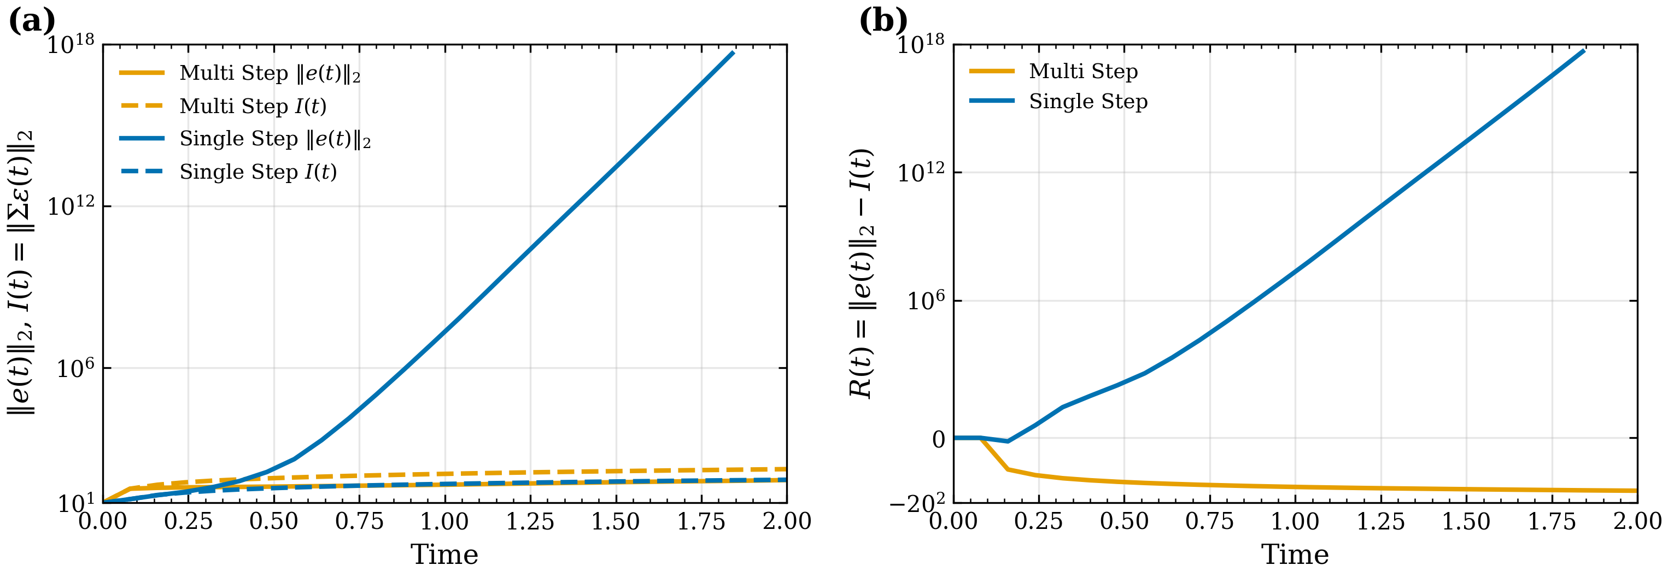
MECHANISM
Unrolled training controls the retained error
Identical architecture and step size, trained with the unrolled loss over a single step versus 15 steps. (a) Rollout error ‖e(t)‖₂ (solid) and injection I(t) (dashed). (b) Retained error R(t) = ‖e(t)‖₂ − I(t).
The two models inject comparably; single-step training leaves the retained error uncontrolled and R grows without bound, while multi-step training drives R negative — net damping. Training, not Δt, sets the retained error.
10

Slide 11
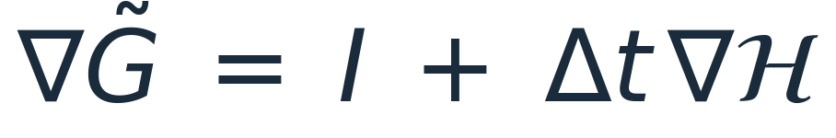
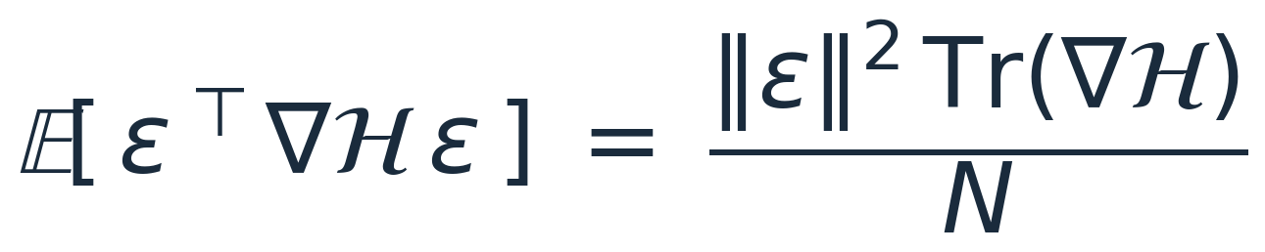
THEORY — DIAGNOSTIC
The Jacobian trace as a damping diagnostic
Differentiating the update of Eq. (1), the full step Jacobian is the identity plus Δt times the tendency Jacobian.
Advancing an error through one step therefore perturbs its norm, at leading order, through the quadratic form εᵀ∇ℋε.
For a random error vector, the expected quadratic form reduces to the trace (Hutchinson identity).
A negative normalized trace Tr(∇ℋ)/N signals expected per-step contraction of the error — a rollout-free diagnostic of the retained error.
11

Slide 12


EXPERIMENTAL DESIGN
Fixing compute makes the tradeoff well-posed
Assumption 1 — fixed inference budget
A rollout to horizon T requires T/Δt forward passes; at fixed inference FLOPs, network capacity is therefore proportional to step size, with coarser steps affording larger networks.
one-step error scaling
Assumption 2 — fixed training budget
The unrolled loss spans n autoregressive steps at cost ∼ nC per backward pass; fixing this cost gives n ∝ 1/Δt, so every model is unrolled to the same physical training horizon at its own resolution.
Consequence: additional unrolled steps per backward pass drive the learned operator toward stronger diffusion.
learned Jacobian trace scaling
With equal backward-pass counts, total training and inference costs are identical across the Δt grid.
12

Slide 13
EXPERIMENTS
Experimental setup
1
Multiple inference-compute budgets
A large collection of models is trained under inference constraints of 350M, 700M, 1.4B, 3B and 6B FLOPs per rollout; each budget defines one iso-FLOP curve.
2
A step-size sweep within each budget
At every budget, models are trained across Δt ∈ [0.01, 0.4], with network capacity scaled in proportion to Δt (Assumption 1).
3
Matched training cost
Each model is unrolled over n ∝ 1/Δt autoregressive steps per backward pass (Assumption 2), with an equal number of backward passes across the grid; a per-Δt output standardization equalizes the loss magnitude across step sizes.
4
A common physical horizon
All models are trained to the same physical final time; every iso-FLOP curve therefore compares models at identical physical training and evaluation horizons.
13

Slide 14
TESTBED
Forced two-dimensional turbulence
Models are trained to predict the vorticity field of forced two-dimensional turbulence on a β-plane at varying network step sizes. Training data are generated by dealiased pseudo-spectral direct numerical simulation (py2d) with no subgrid closure.
Re = 1000
256 × 256
β = 20
Reynolds number
grid, 2π-periodic domain
β-plane parameter
α = 0.1
10⁻⁴
10⁻²
Rayleigh drag coefficient
DNS solver time step
snapshot interval
The DNS step is fixed by numerical stability; the emulator step sizes studied below are one to three orders of magnitude coarser.
14

Slide 15
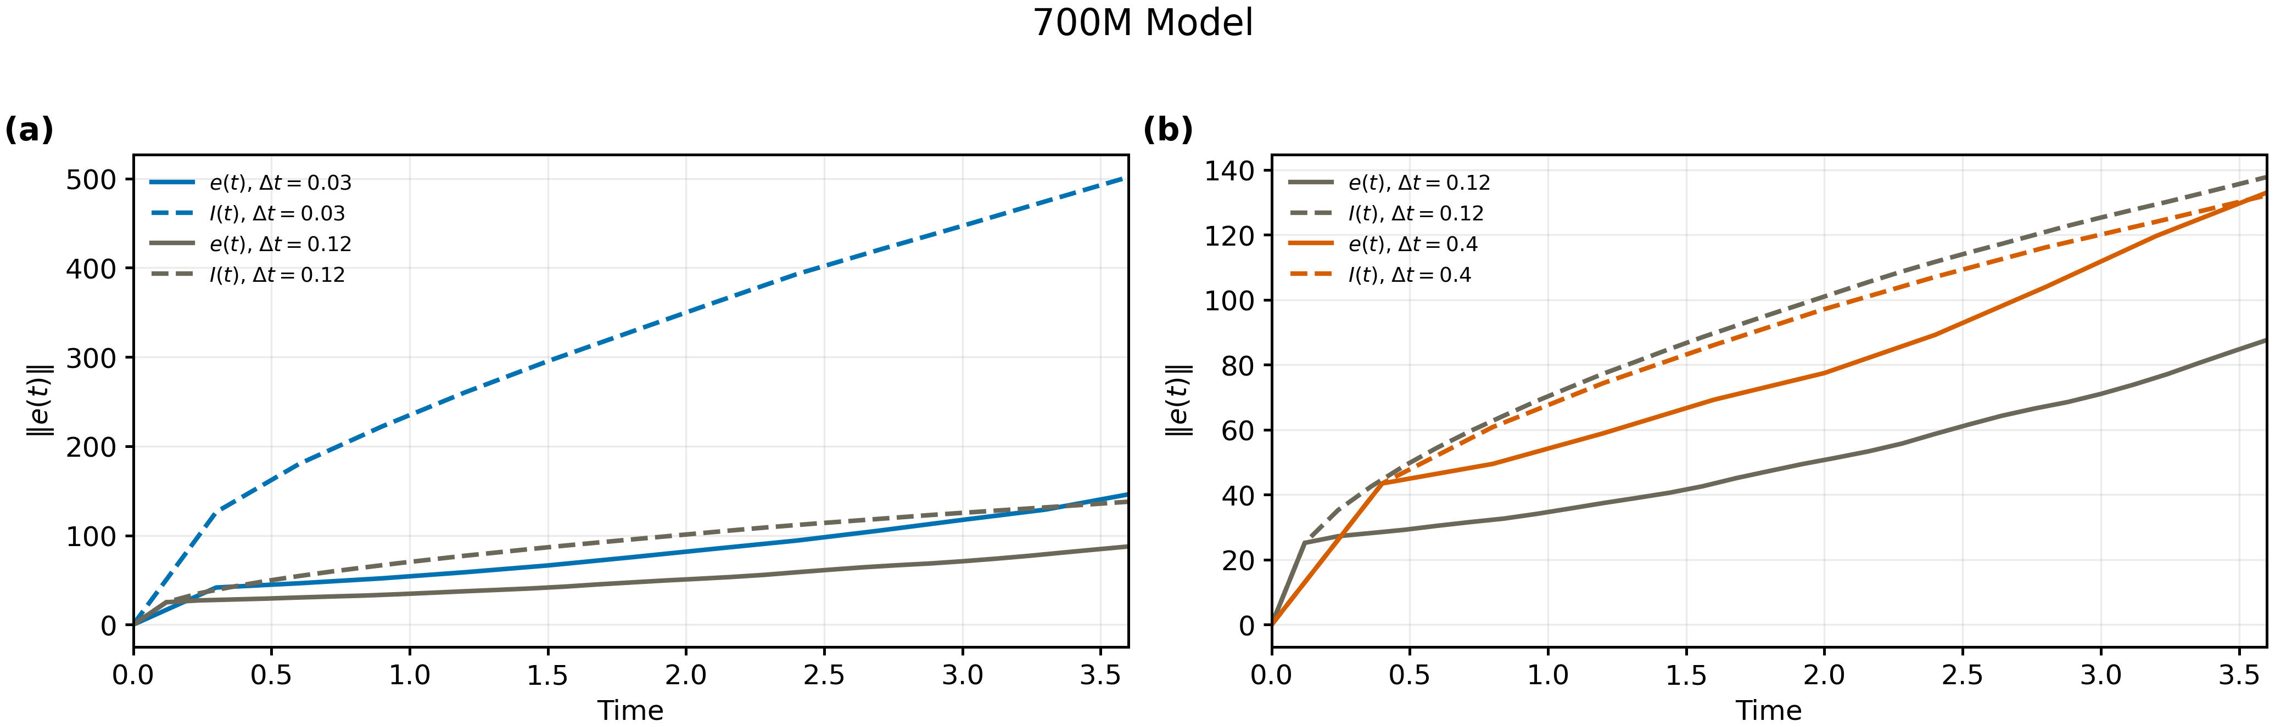
RESULTS
Retention-dominated versus injection-dominated error
700M budget shown; rollout error ‖e(t)‖ (solid) and injection I(t) (dashed), with Δt = 0.12 as the common reference in both panels. (a) At Δt = 0.03 the injected error far exceeds the realized error. (b) At Δt = 0.4 the two curves nearly coincide.
The vertical gap between I(t) and e(t) is the retained error R: large at fine steps, where the learned map damps most of the injected error, and collapsing at coarse steps, where injection alone sets the error.
15

Slide 16
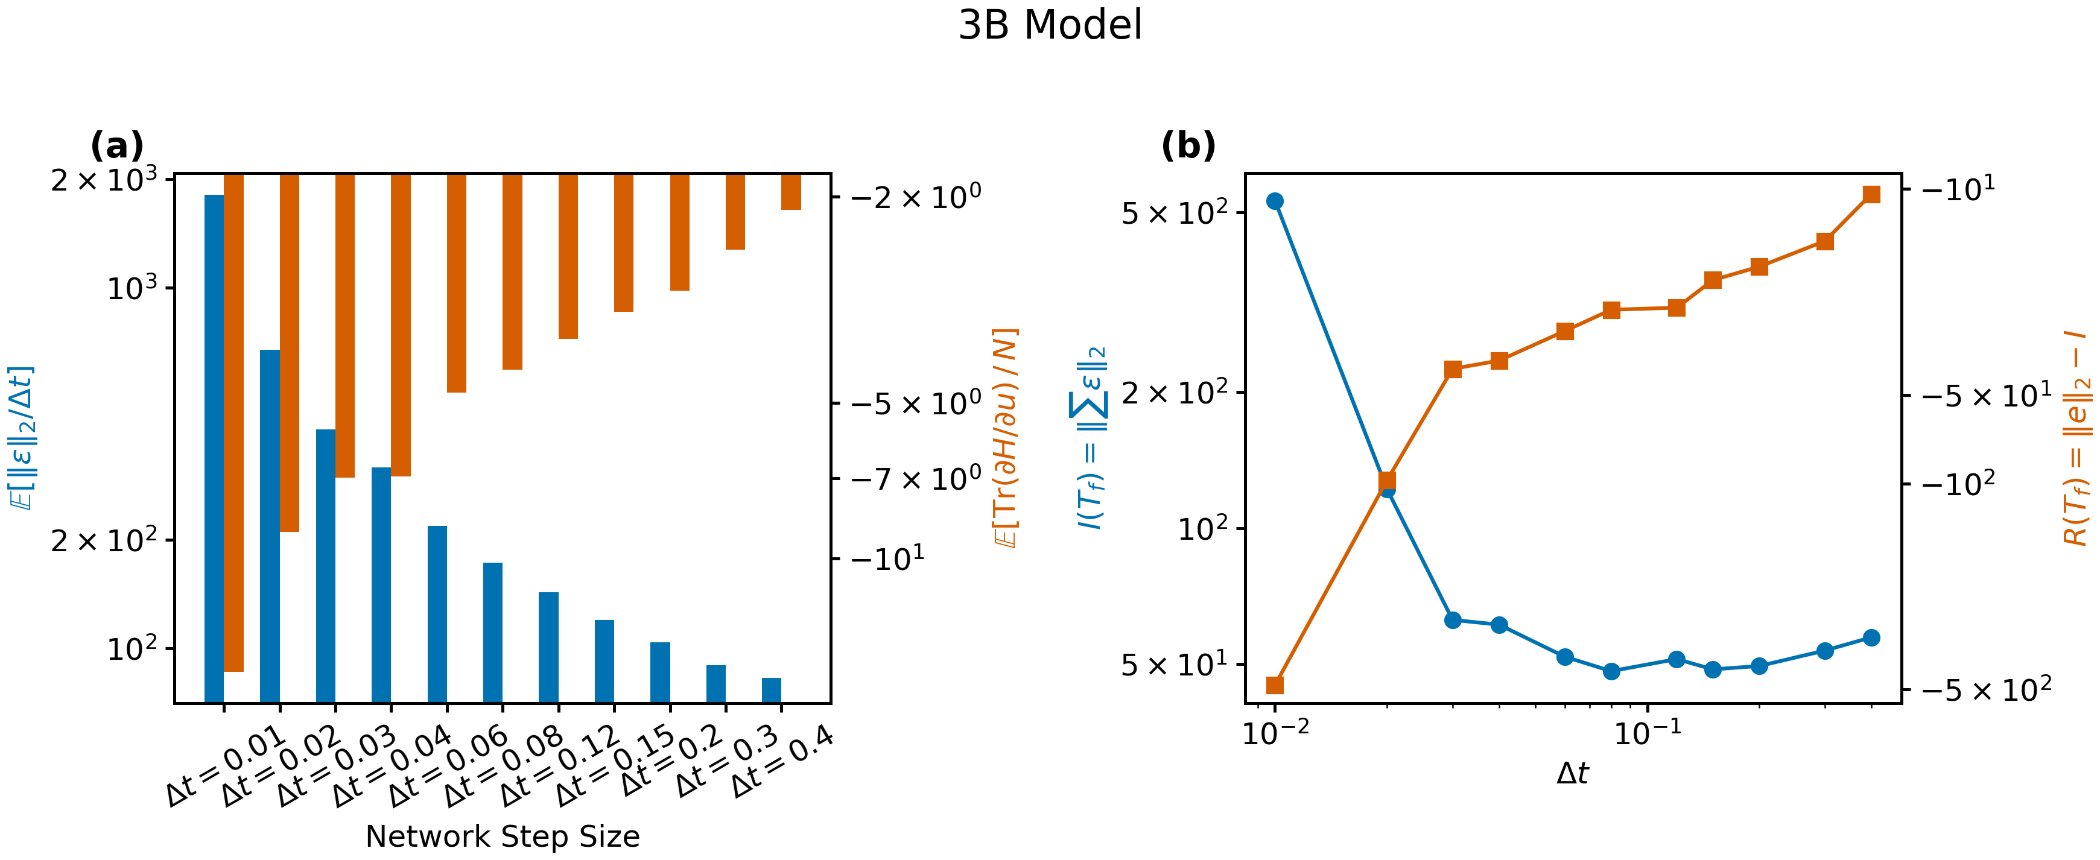
RESULTS
The two error channels across the step-size sweep
3B budget shown. (a) Expected normalized one-step error 𝔼[‖ε‖₂/Δt] and expected Jacobian trace 𝔼[Tr(∂ℋ/∂u)]/N by step size. (b) I(T_f) decreases with Δt while the retained error R(T_f) = ‖e‖₂ − I, negative throughout, approaches zero: net damping weakens at coarser steps.
The two channels are measured independently at every Δt; their opposing trends constitute a test of the mechanism, and their sum reconstructs the rollout error norm exactly (‖e‖ = I + R).
16

Slide 17
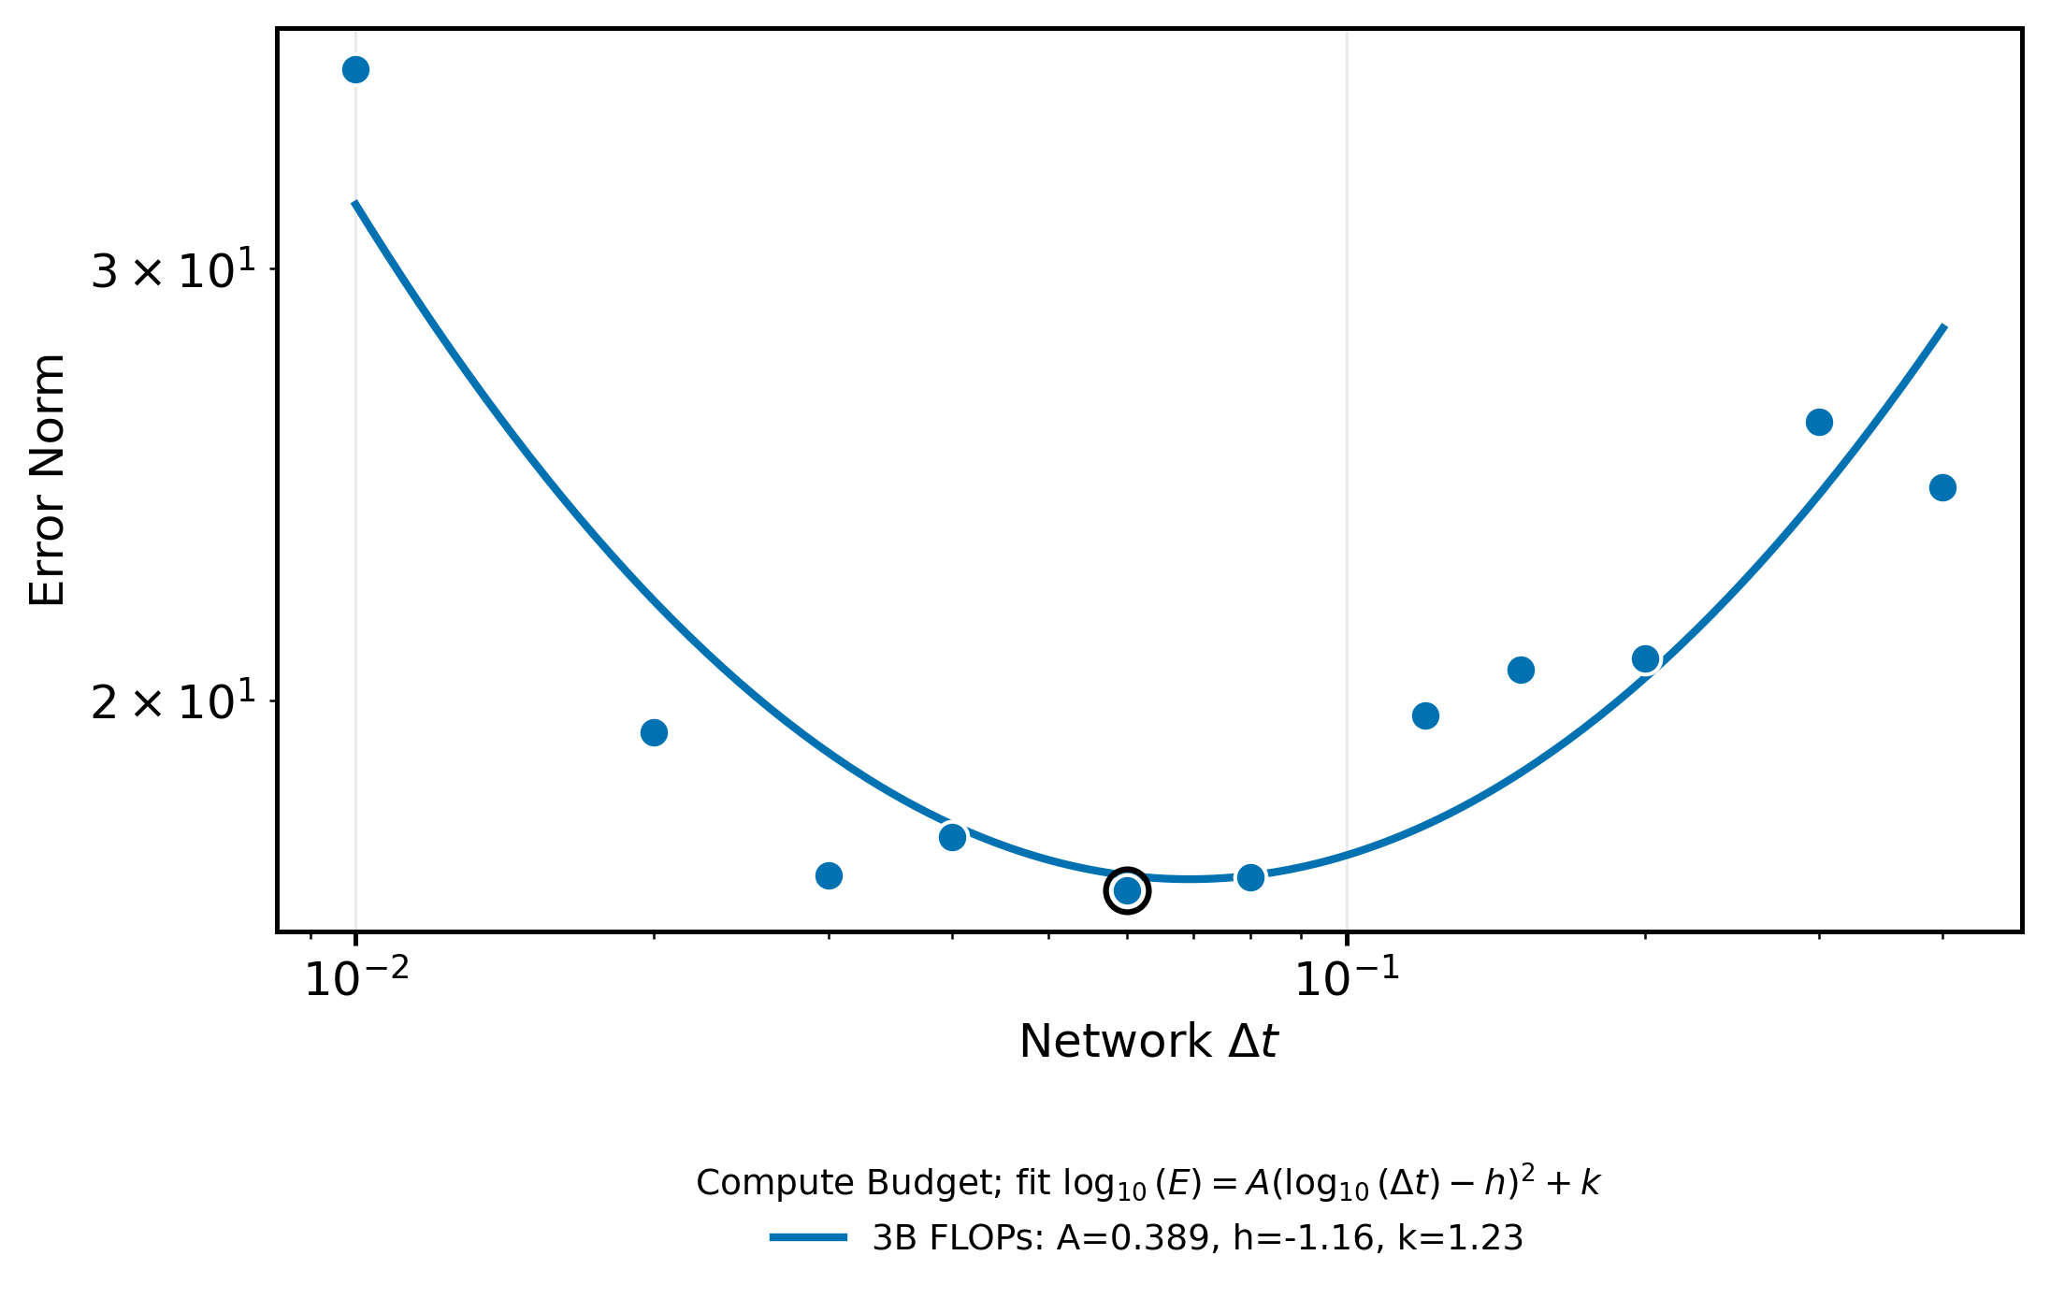
RESULTS
An interior error minimum in Δt
Fine steps: at fixed compute the network is smaller — the per-unit-time error rises.
Coarse steps: training unrolls over only a few steps — the network never learns to damp the retained error.
interior minimum Δt*
3B FLOP budget; rollout error versus network Δt with a quadratic log–log fit. The circled marker is the fitted minimum Δt*.
Both limits are penalized at fixed compute, so the error curve is U-shaped with an interior minimum Δt* — the quantity whose budget dependence is mapped next.
17

Slide 18
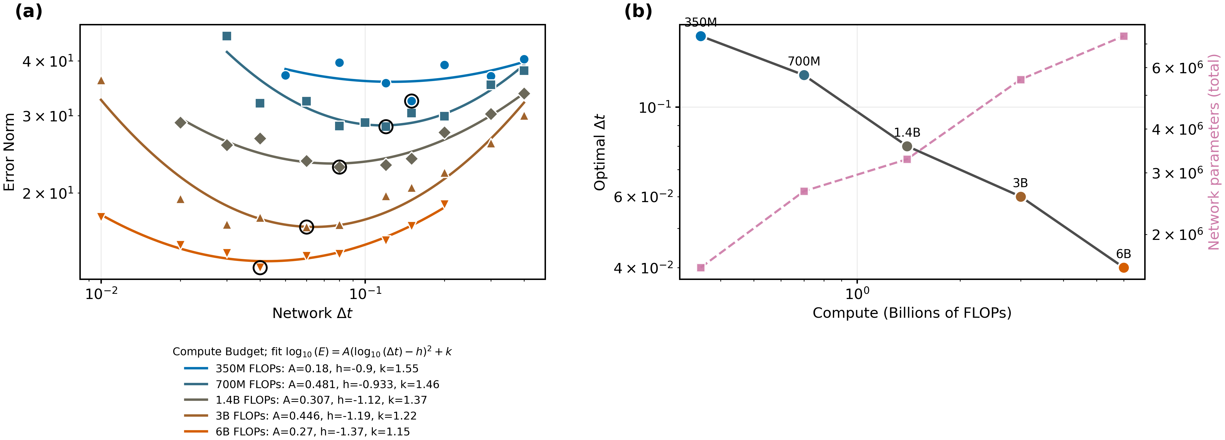
RESULTS
An interior error minimum in Δt — shifting with budget
(a) Rollout error vs. network Δt for each compute budget, with quadratic log-log fits; circled markers = per-budget minima. (b) The minimizing Δt falls while the parameter count at the minimum grows with budget.
Under the fixed-compute constraints, every budget yields a U-shaped error curve with an interior minimum, and the minimizing Δt* falls steadily as the compute budget grows.
18

Slide 19
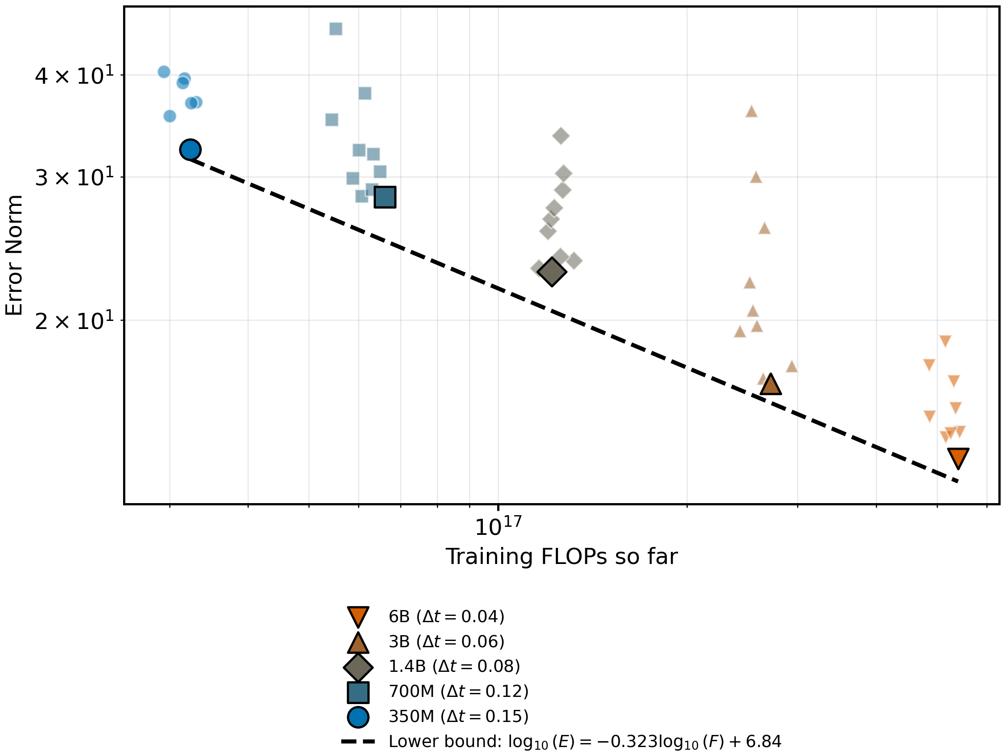
RESULTS
The per-budget minima trace a compute-scaling frontier
Evaluating each budget at its error-minimizing step size yields a power-law frontier of error against compute.
Models at other step sizes lie strictly above the frontier at every budget.
The lowest observed error allocates additional compute between capacity and finer temporal resolution, rather than to either alone.
Rollout error vs. training FLOPs at epoch 30; per-budget minima (large markers) trace the frontier log₁₀(E) = −0.323 log₁₀(F) + 6.84.
19

Slide 20
TAKEAWAYS
The step size of a neural emulator is a compute-allocation problem with an interior error minimum.
1
Unroll, then order by Δt
Unrolling the recursion organizes the rollout error as a series in powers of Δt; the step size determines which orders of the series dominate.
2
Fix the compute budget
Equal inference and training budgets across the Δt grid render the residual, learned Δt-dependence a well-posed tradeoff.
3
Two channels, one crossing
Under the fixed-compute constraints, injection and retention vary oppositely with Δt; the error-minimizing Δt* lies at their balance and shifts toward finer steps as the budget grows.
C. Ainslie, Baskin Engineering, UC Santa Cruz · August 2026

Slide 21
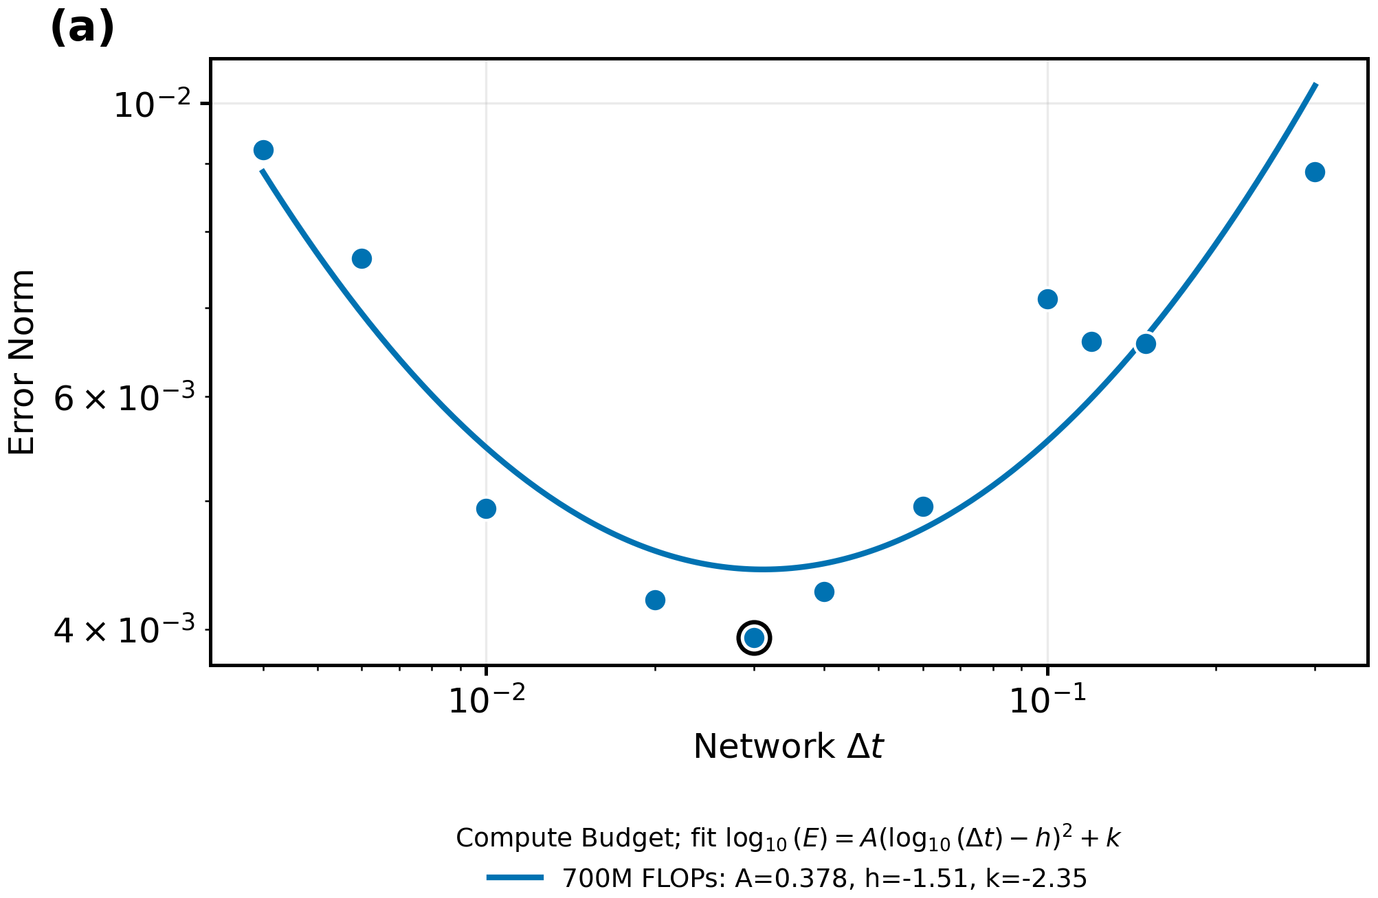
WORK IN PROGRESS — KURAMOTO–SIVASHINSKY (1D)
A 700M iso-FLOP curve on KS
Interior minimum present; learning rate (10⁻⁴) not yet tuned per Δt — overall performance subpar.
21

Slide 22
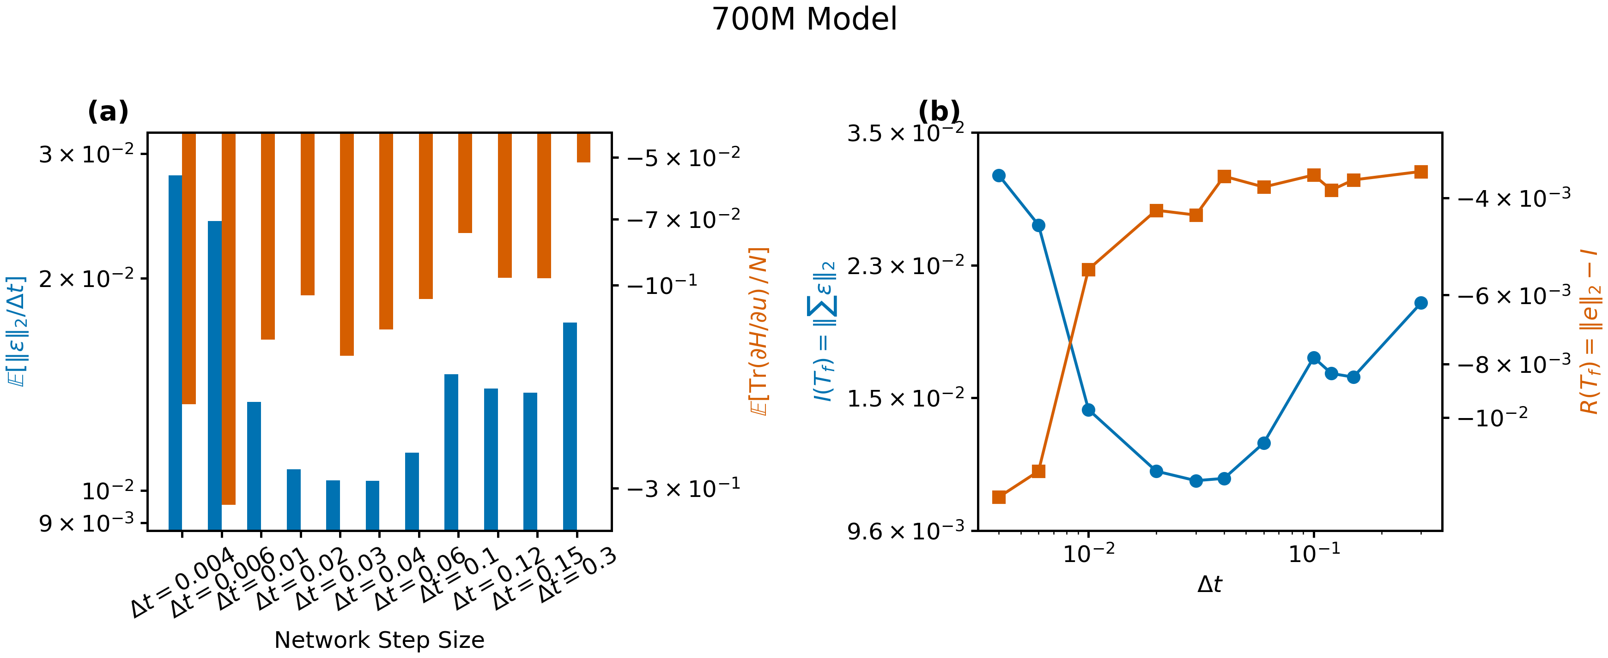
WORK IN PROGRESS — KURAMOTO–SIVASHINSKY (1D)
Error channels at 700M
22

Slide 23
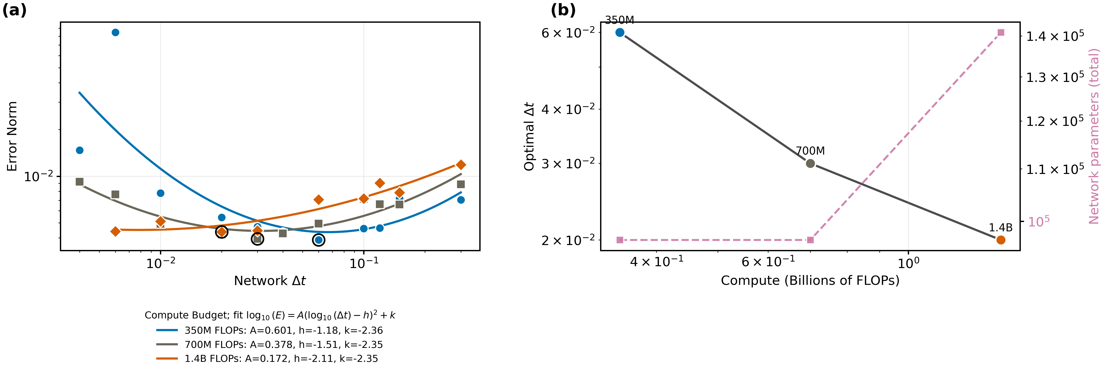
WORK IN PROGRESS — KURAMOTO–SIVASHINSKY (1D)
Minima across three budgets (preliminary)
350M–1.4B; the minimizing Δt decreases with budget.
23

Slide 24
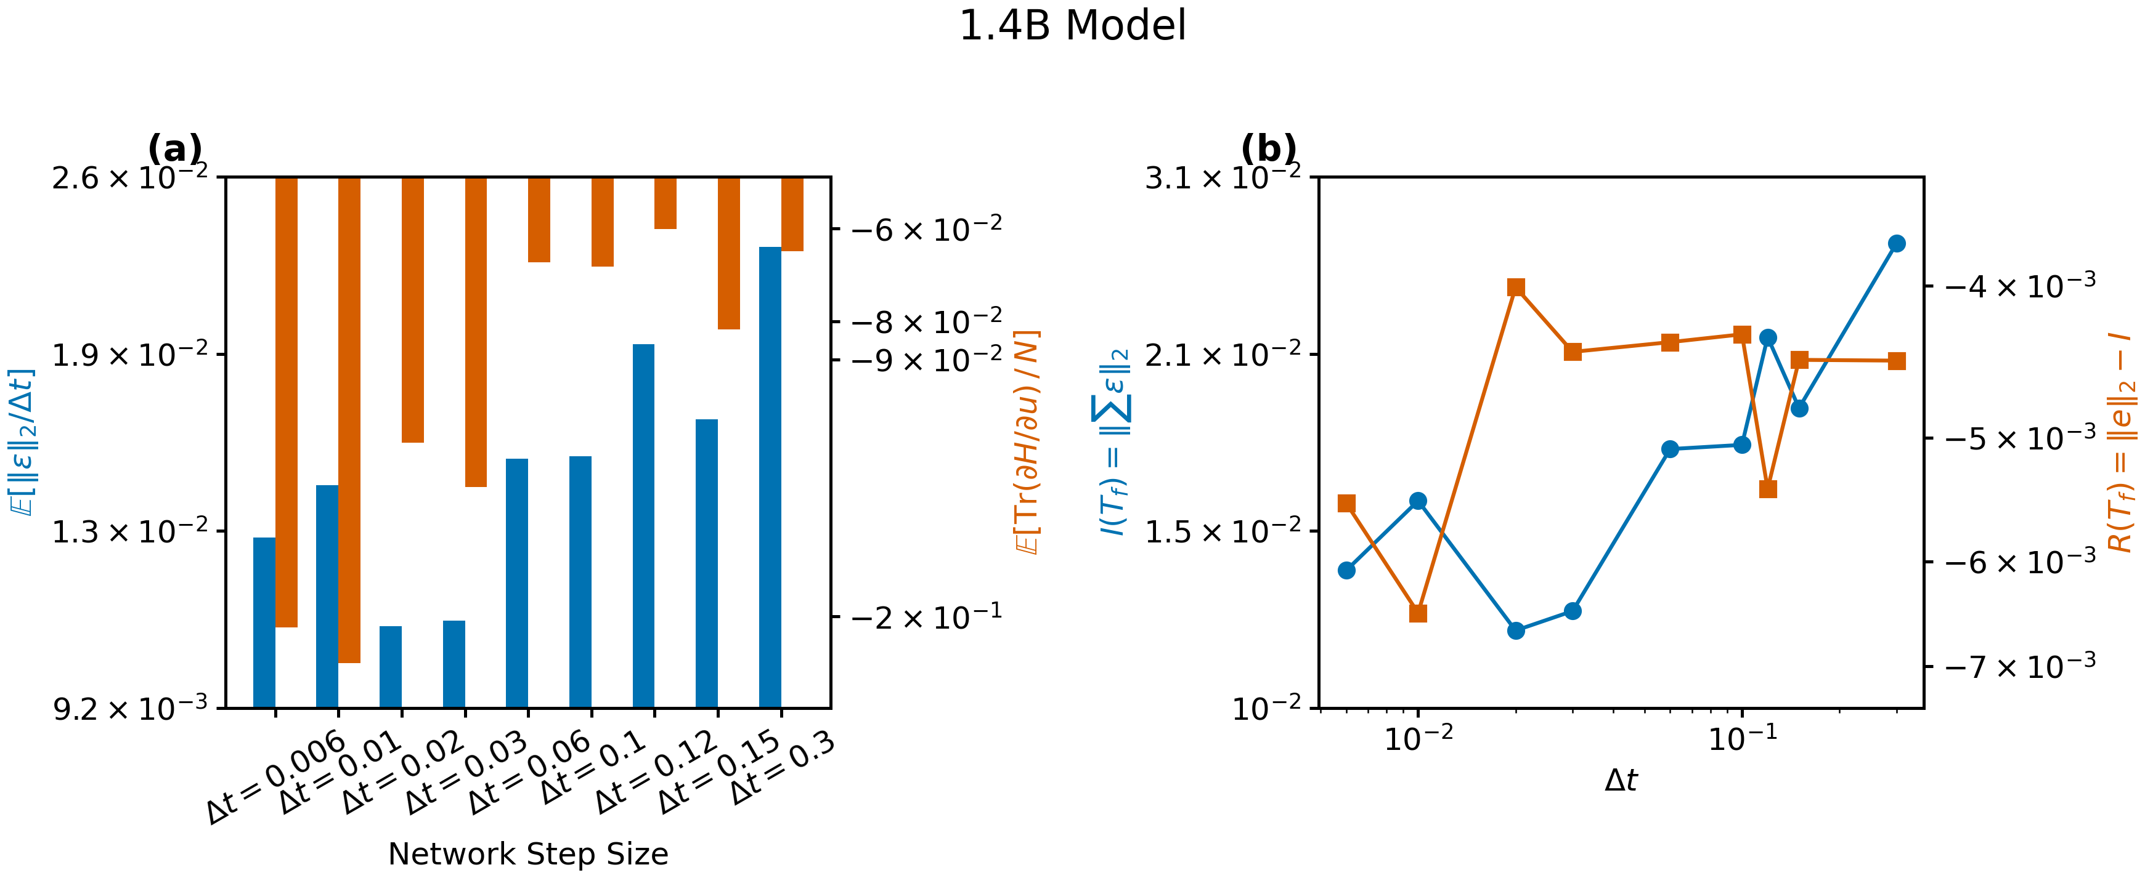
WORK IN PROGRESS — KURAMOTO–SIVASHINSKY (1D)
Error channels at 1.4B
Trends noisier at 1.4B — consistent with the untuned learning rate.
24

